Slide 1
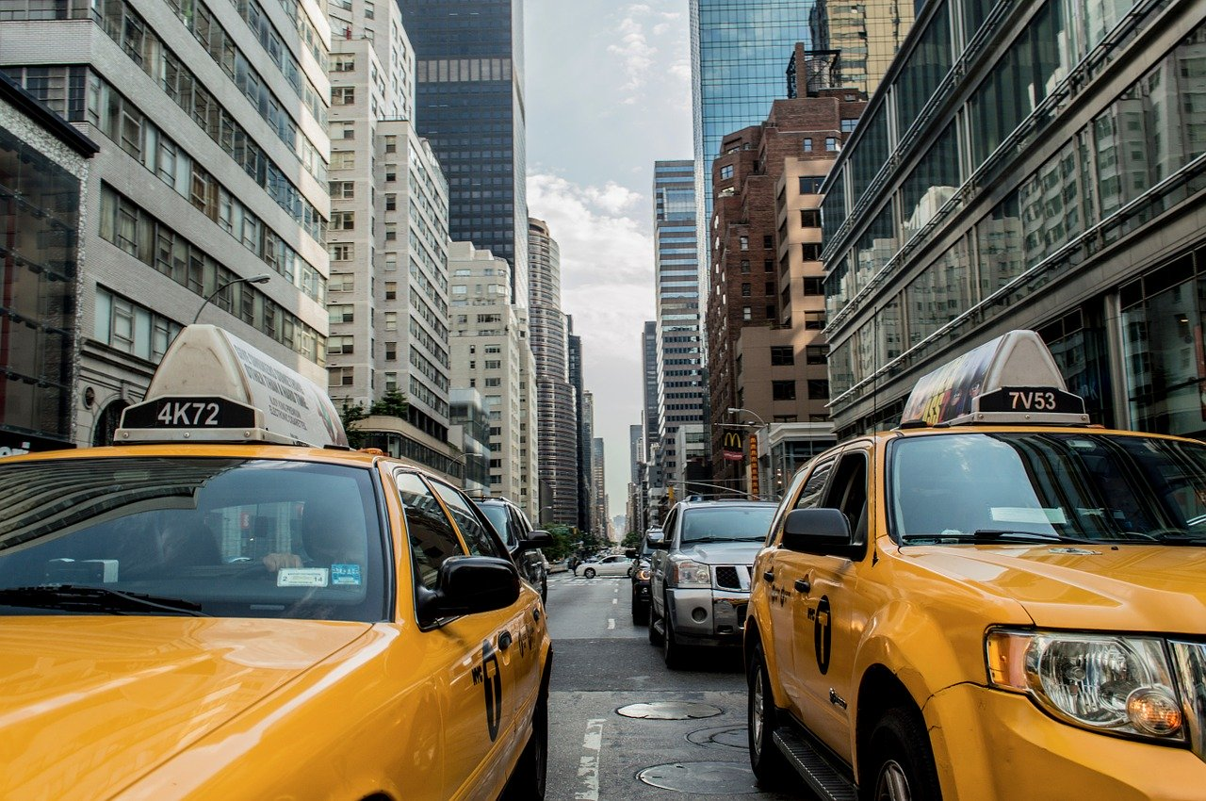
Reclaiming NYC Streets
An Analytical Case Study of NYC Taxi Data

Slide 2

Problem Statement
Question and Context

Slide 3
How can NYC Taxi & Limousine Commission (TLC) increase cab ridership?

Slide 4
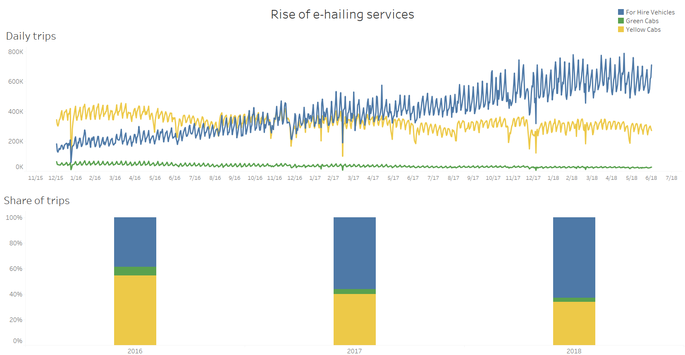
Notes:
TLC Factbook data : https://www1.nyc.gov/site/tlc/about/fact-book.page

Slide 5
Problem Exploration & Analysis

Slide 6
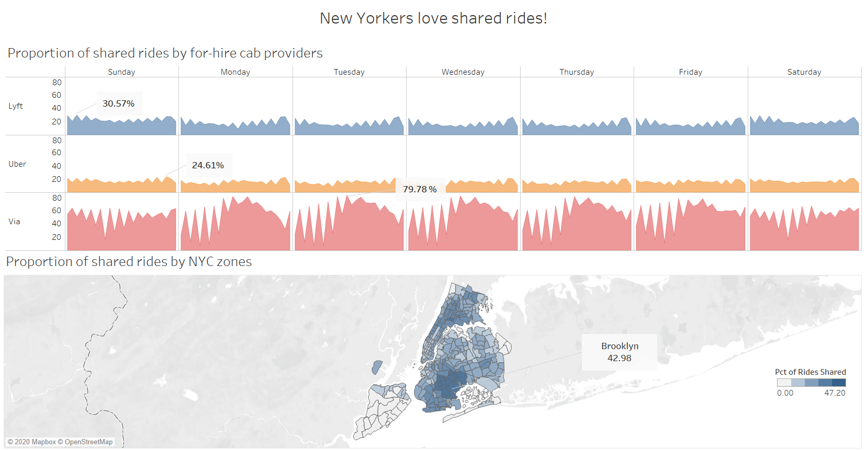
Add process step here
Add process step here
Notes:
Multi level grouping of ride data
TLC Factbook Data: https://www1.nyc.gov/site/tlc/about/fact-book.page

Slide 7

Strategy 1 – Shared Rides
7.6M
2.1M
70%
Total rides
Potential shared rides
Congestion surcharge reduction
1
Group all rides based on the route taken
2
Group rides within the same day, hour and 15-minute interval
3
# of such rides = # of potential shared rides
Add process step here
Notes:
Multi level grouping of ride data

Slide 8
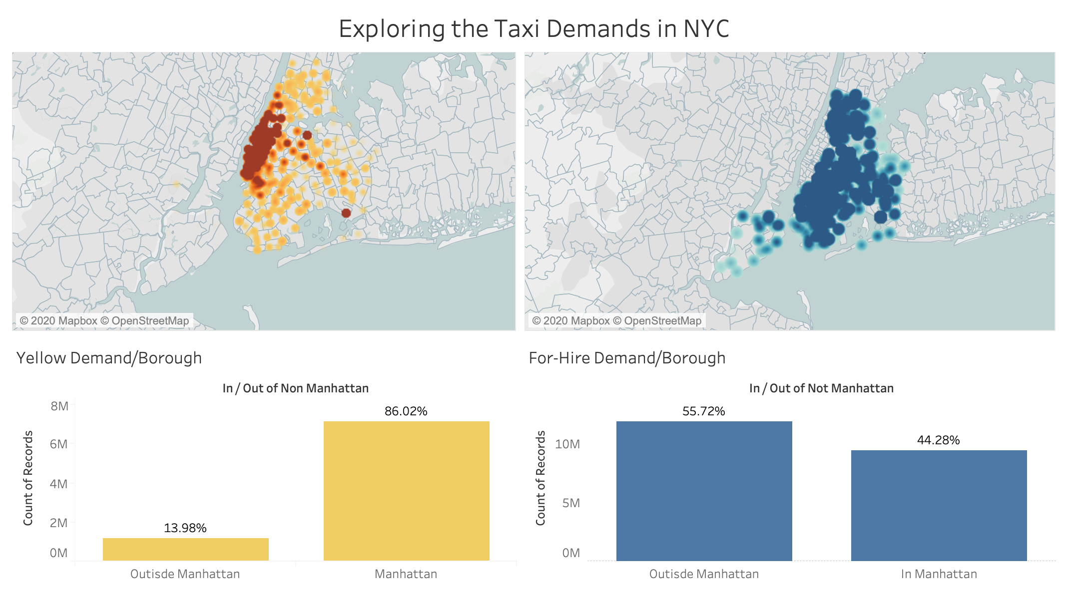
Notes:
https://opendata.cityofnewyork.us/
https://www1.nyc.gov/site/tlc/about/tlc-trip-record-data.page

Slide 9
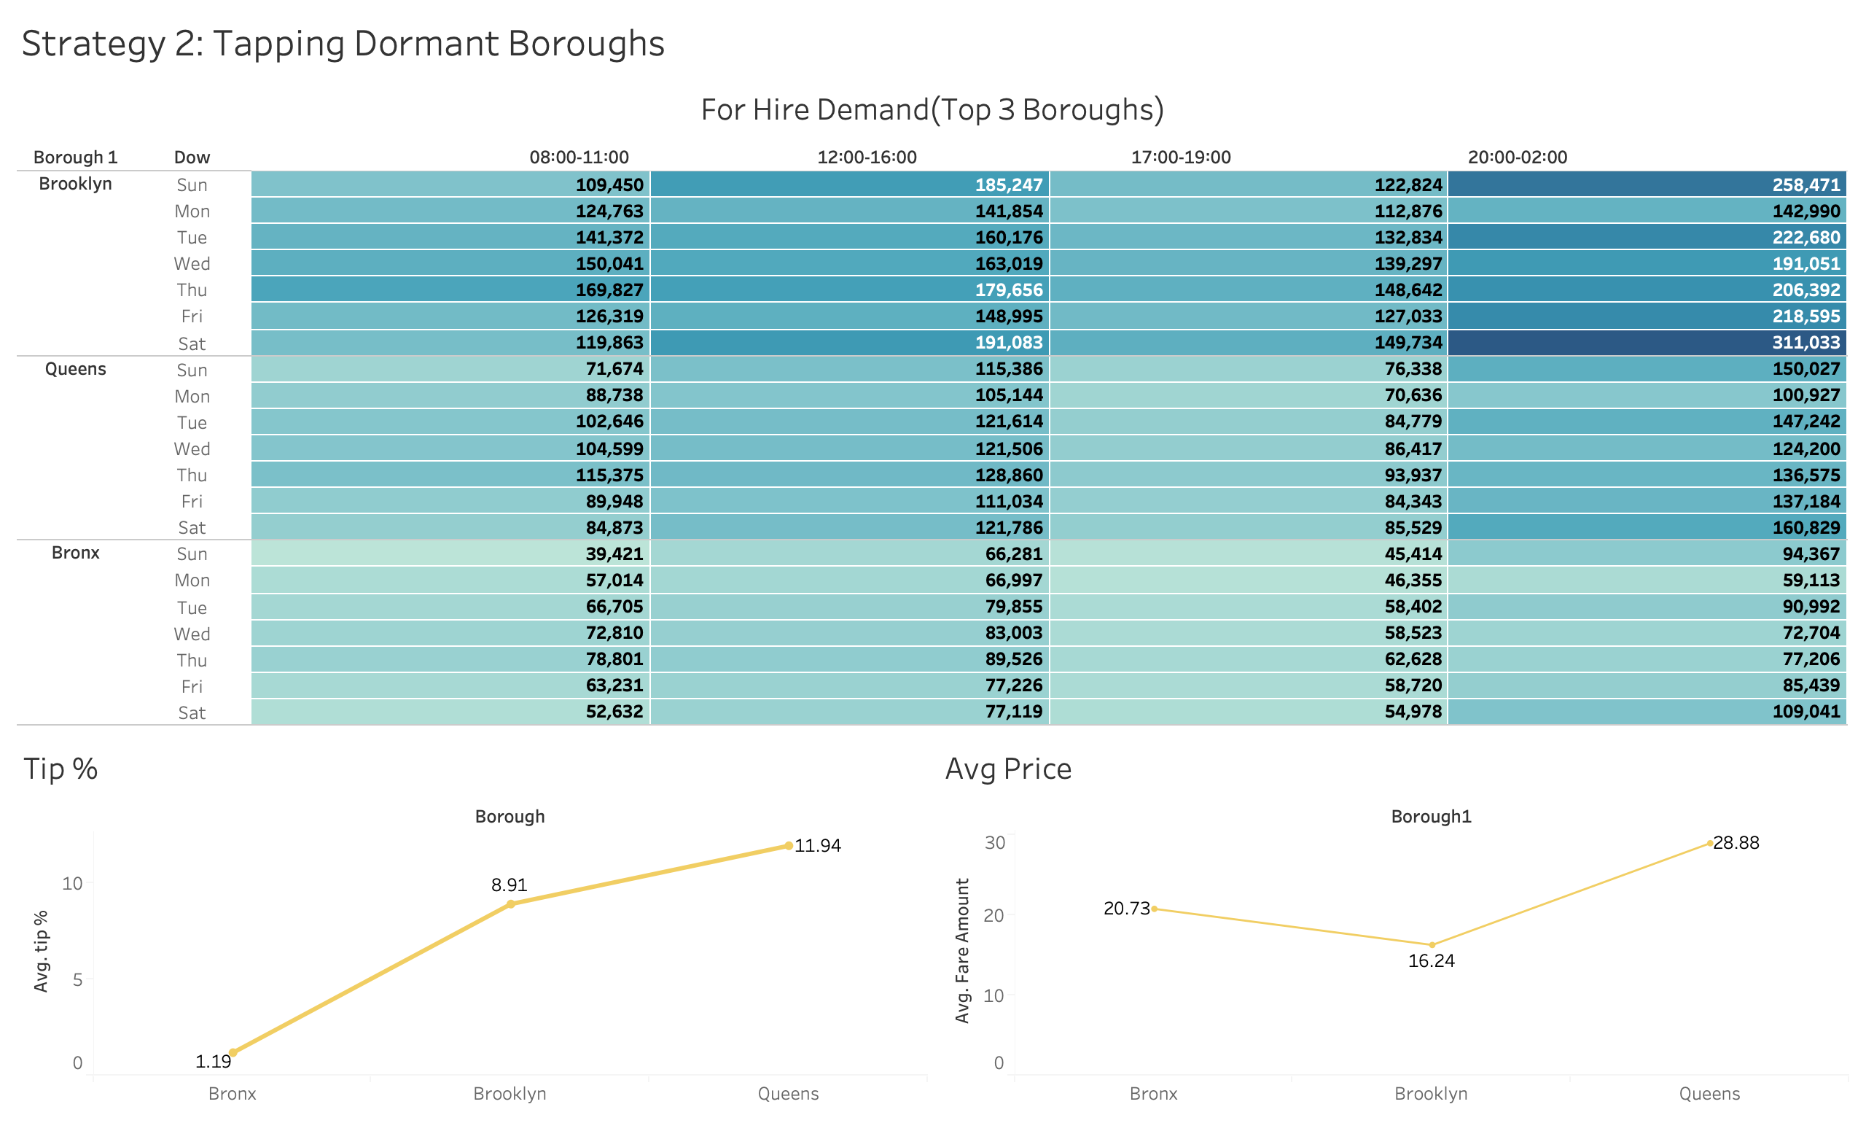
Notes:
https://opendata.cityofnewyork.us/
https://www1.nyc.gov/site/tlc/about/tlc-trip-record-data.page

Slide 10
Marketplace Forecasting
Add process step here
Notes:
Multi level grouping of ride data
https://opendata.cityofnewyork.us/
https://www1.nyc.gov/site/tlc/about/tlc-trip-record-data.page

Slide 11
Recommendation

Slide 12

Recommendation
Package the solutions in an app and roll-out to customers and taxi drivers
Provide estimated trip fare to the customer
Provide real-time demand forecasting to drivers
Allow customers to book shared rides

Slide 13
Future Recommendations
Develop a customer feedback system
Incorporate Dynamic Pricing
Notes:
Develop a customer feedback system

Slide 14

Thank You

